Slide 1


e-Mobility for ALL
2023
RASD & DD
Riccardo Bravin Elia Feltrin
Milano,
17 febbraio 2023

Slide 2
RASD
Requirements Analysis and Specification Document

Slide 3
Goals
RASD
G1 | Allow user to pay for a charge
G2 | Allow user to book a charge
G3 | Allow user to register to the eMSP system
G4 | Allow user to know about charging station prices and special offers
G5 | Allow user to perform a charging process
G6 | Allow user to make reservations
G7 | Allow CPMS to manage manually or automatically the power input/output of the charging station
Notes:
The systems goals encompass all the functionalities required by the client. More specifically the system should be able to handle registrations, bookings and payments while also enabling the user to know about charging station positions, prices and special offers. The CPMS subsystem instead should handle reservations and all the power delivery and retrieval of the charging stations.
Goal 5 joins these two sections which need to communicate to accomplish a common task, performing a charging process.
This is the process we will now see as a use case.

Slide 4
Use case Charging Process
RASD
Actor: User
Entry Conditions: reservation has been previuosly made
Event Flow:
User selects desired reservation from list on eMSP app that cumunicate the user identity and the selected charging column to the CPMS
User plugs the car and the charging process start. The user will be notified 10 minutes before the end of the process
CPMS comunicate the final bill to the user throught the eMSP app, that makes the payment
If the charging spot is freed before the end of the reservations, the CPMS makes the remaining time available to other users
Notes:
The user is the actor which needs to have previously made a reservation then the event flow follows 4 main sections…

Slide 5
Most important Requirements
RASD
R6 | eMSP shall allow registered users to make a reservation to a specific CS at a specific date
R7 | eMSP must show registered users correct positional data and nearby charging stations
R18 | CPMS must be able to automatically decide how to manage its own battery and net power
R19 | CPMS must be able to automatically decide which DSO buy energy from
R20 | CPMS must be able to answer eMSP requests for free timeframes and relative prices
Notes:
The most important requirements are, for wat concerns the eMSP, finding the wanted or nearby charging station while also being able to make reservations at specific timeframes for a given user, and for the CPMS, the automation and management of the charging area power and reservations. The CPMS needs to also be able to handle requests from the eMSP of informations about free timeframes and charging prices

Slide 6
Most important Assumptions
RASD
D1 | During the night hours energy is less expensive
D3 | After a vehicle reserved time-frame finishes the charging socket is freed in 5 minutes
D[5-10] | There exists APIs that enable comunication between the different parts of the systems external modules
Notes:
The most important assumptions are the ones the concern the CMPS management such as the fact that energy during the night is less expensive, this is for power handling purposes, and that after a vehicle timeframe ends or the car finishes charging, the user frees the charging socket and spot in 5 minutes after the end.
The last assumption is an aggregate of all assumpions that entail the use of an API to manage external services such as payment and DBMSs

Slide 7
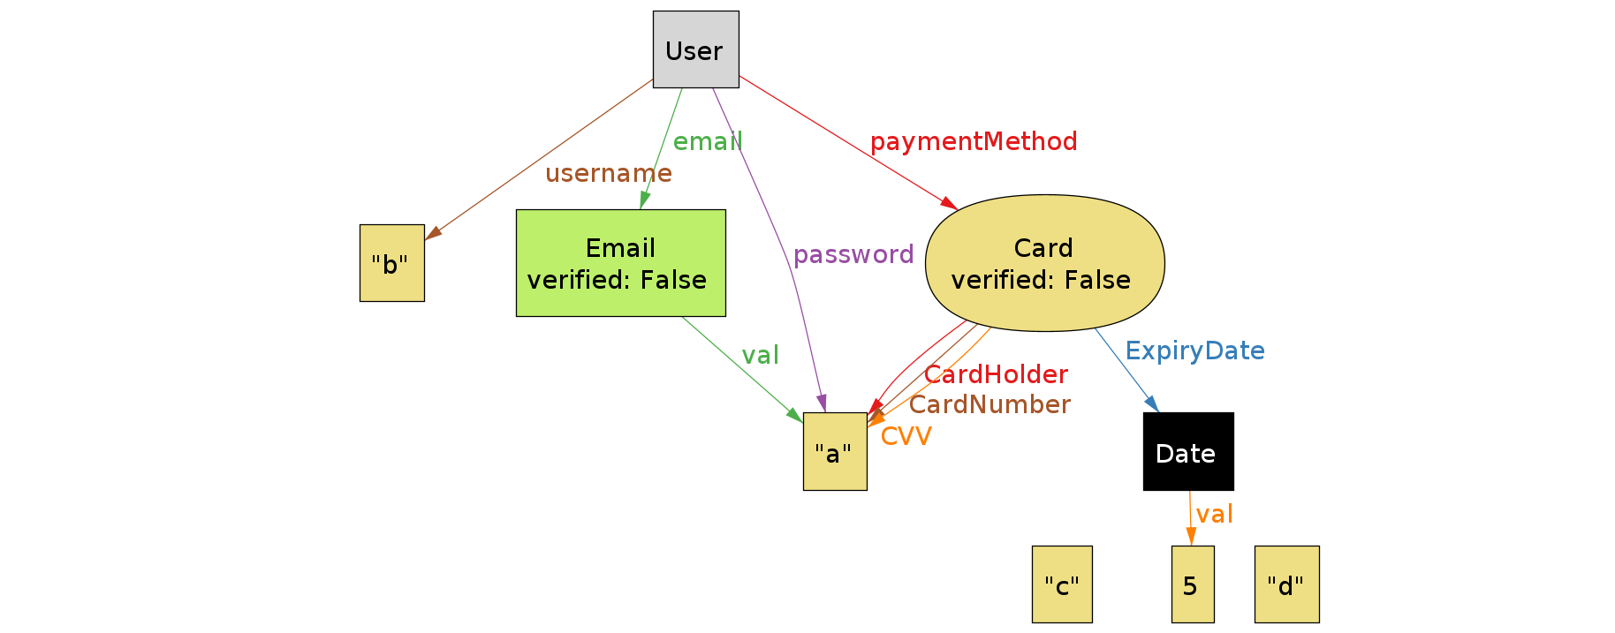
Alloy model eMSP World
RASD
Notes:
With the model we want to show how the relations between systems and objects is coherent with the real world and all elements needed for the implementation of the software can cohexist in the modeled world There also are reservations that are the entity that links the CPMS and eMSP worlds by connecting users and charging stations with one another

Slide 8
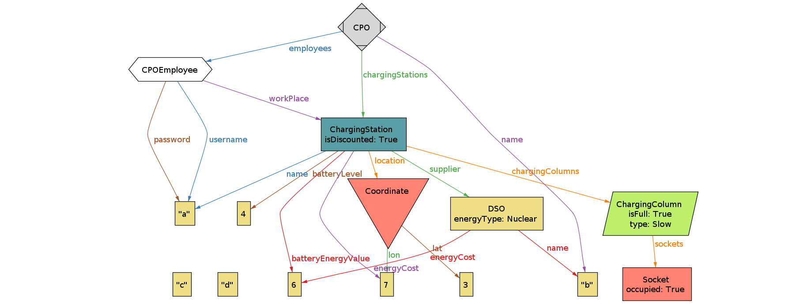
Alloy model CPMS World
RASD
Notes:
With the model we want to show how the relations between systems and objects is coherent with the real world and all elements needed for the implementation of the software can cohexist in the modeled world There also are reservations that are the entity that links the CPMS and eMSP worlds by connecting users and charging stations with one another

Slide 9
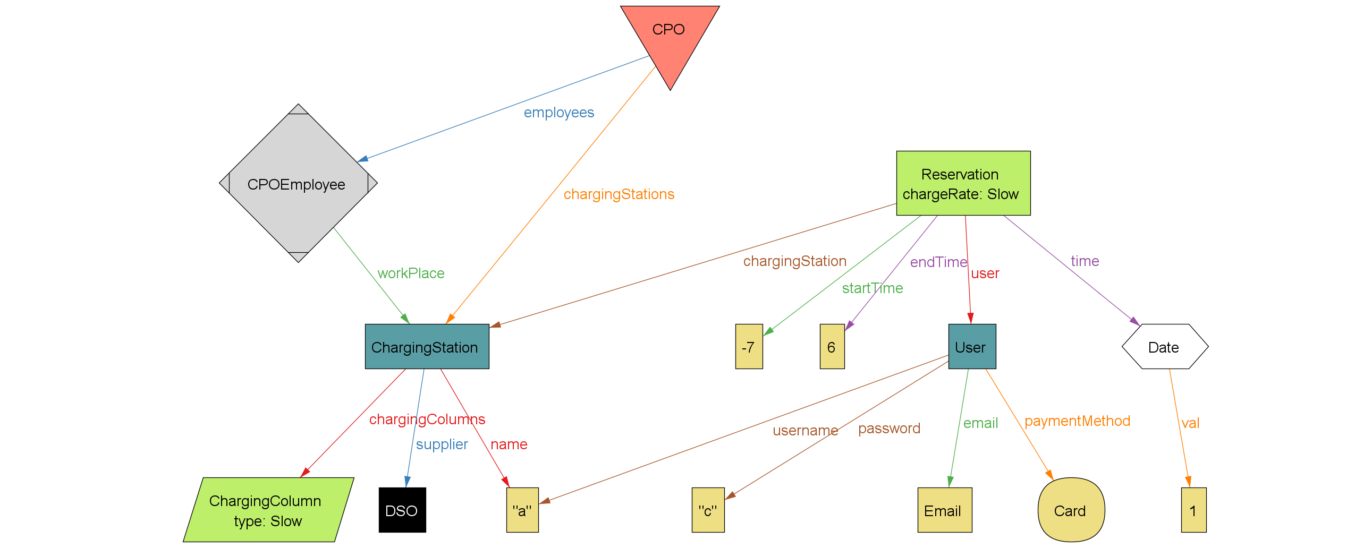
Alloy model Reservations
RASD
Notes:
With the model we want to show how the relations between systems and objects is coherent with the real world and all elements needed for the implementation of the software can cohexist in the modeled world There also are reservations that are the entity that links the CPMS and eMSP worlds by connecting users and charging stations with one another

Slide 10
DD
Design Document

Slide 11
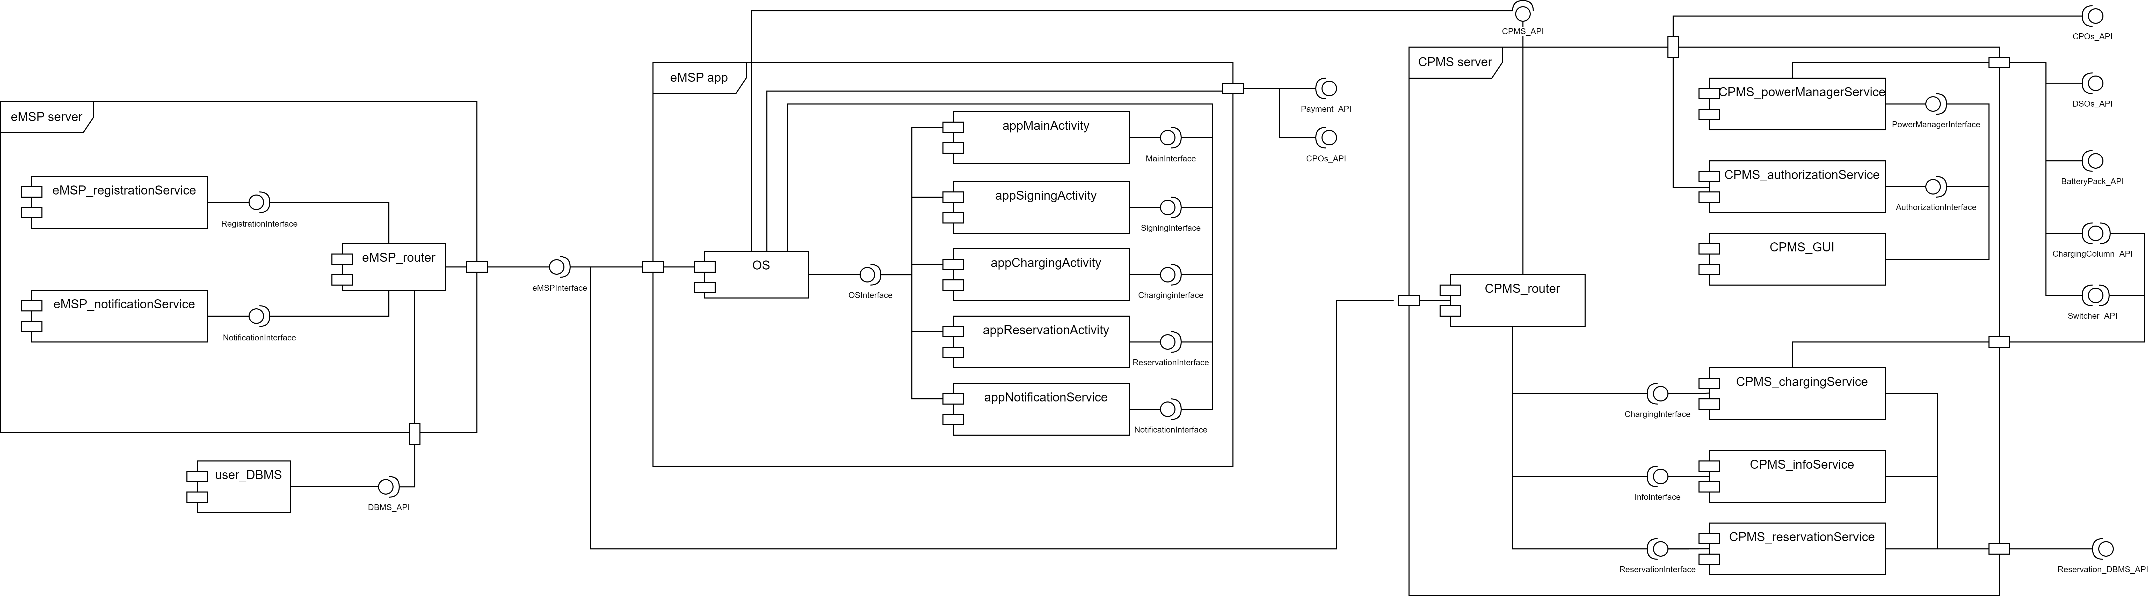
System components view
DD
Notes:
eMSP app:
eMSP server:
CPMS server
Let’s take a closer look to this subsystems:

Slide 12
System components view eMSP server
DD
Notes:
The eMSP server manages 1) the notification coming from the CPMS server and going to eMSPapp, through a publisher-subscriber architecture, 2) and the registration and login of the final user.

Slide 13
System components view eMSP app
DD
Notes:
For what concern the eMSP app, it is a mobile application, and it’s used by the final user 1)to get information about charging station location and availability 2) register or login to the eMALL system, 3)to carry out the charging process, 4)to manage its own reservation. 5)The appNotificationService is a background process that interact with the OS to show the notification even if the app is not in foreground.

Slide 14
System components view CPMS server
DD
Notes:
CPMS server 1) manages the power input/output of the charging station, either automatically or manually by the CPMS Employee 2)It also interact with the eMSP app and the charging station to carry out the charging process, 3) it gives information about charging station location and availability 4) and takes reservation from the final user

Slide 15
System components interaction
DD
Notes:
For what concerns the interaction between the three subsystems
1)The eMSP app acts as
Client for CPMSserver, client and subsciber for the eMSPserver
This is the only sub-system that directly interact with the final user.
2)The eMSP server acts as
Dispatcher and server for the eMSP app
Dispatcher for the CPMS server
3)And the CPMS server acts as
Publisher fot the eMSP server, server for the eMSP app
This is the subsystem that interact with the CPMS employee.

Slide 16
Component interfaces
DD
Notes:
Each component has a suitable interface that enables the communication paths described in the system component view, both internally to a subsystem and between different subsystem. Due to time constraint, we will not go into detail.

Slide 17
Component interfaces eMSP server
DD

Slide 18
Component interfaces eMSP app
DD
Notes:
mainInterface
GUI interface
powerManagement Interface
Notification interface

Slide 19
Component interfaces CPMS server
DD
Notes:
mainInterface
GUI interface
powerManagement Interface
Notification interface

Slide 20
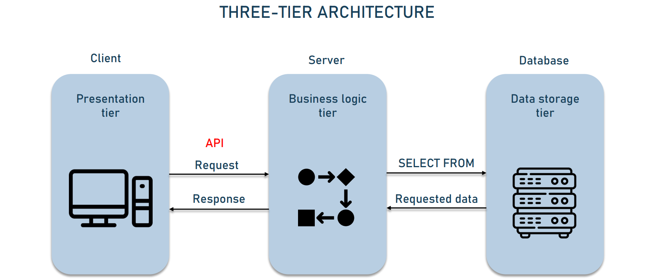
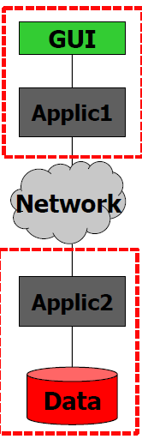
Architectural style and patterns
DD
Notes:
Both the eMSP and the CPMS are implemented following the hree layer architecture
In the eMSP
The resentation and business logic integrated in the varius activities, since embedded OSs enables this behaviour
However, part of the bisness logic is implemented in the eMSP server due to the necessicity of manage connected devices.
The userDBMS implements the Data storage tier.
In the CPMS:
The CPMS_GUIinterface implemets the presentation layer, that is reserved to the CPMS employee,
While all the other components, except for the reservation DBMS that implements the data storage tier, manage the business logic of the system
Describe how the things are divides: eMSP has an APP for the client part, businnes logic is partially inside the app and part on the server and the database is present connected to the server for storage purposes
The CPMS has instead a big sistem that is subdivided in higher level sections with which the internal client interacts while the businnes logic layer takes care of the CS internal power management and interaction with the DBMS for the reservation

Slide 21
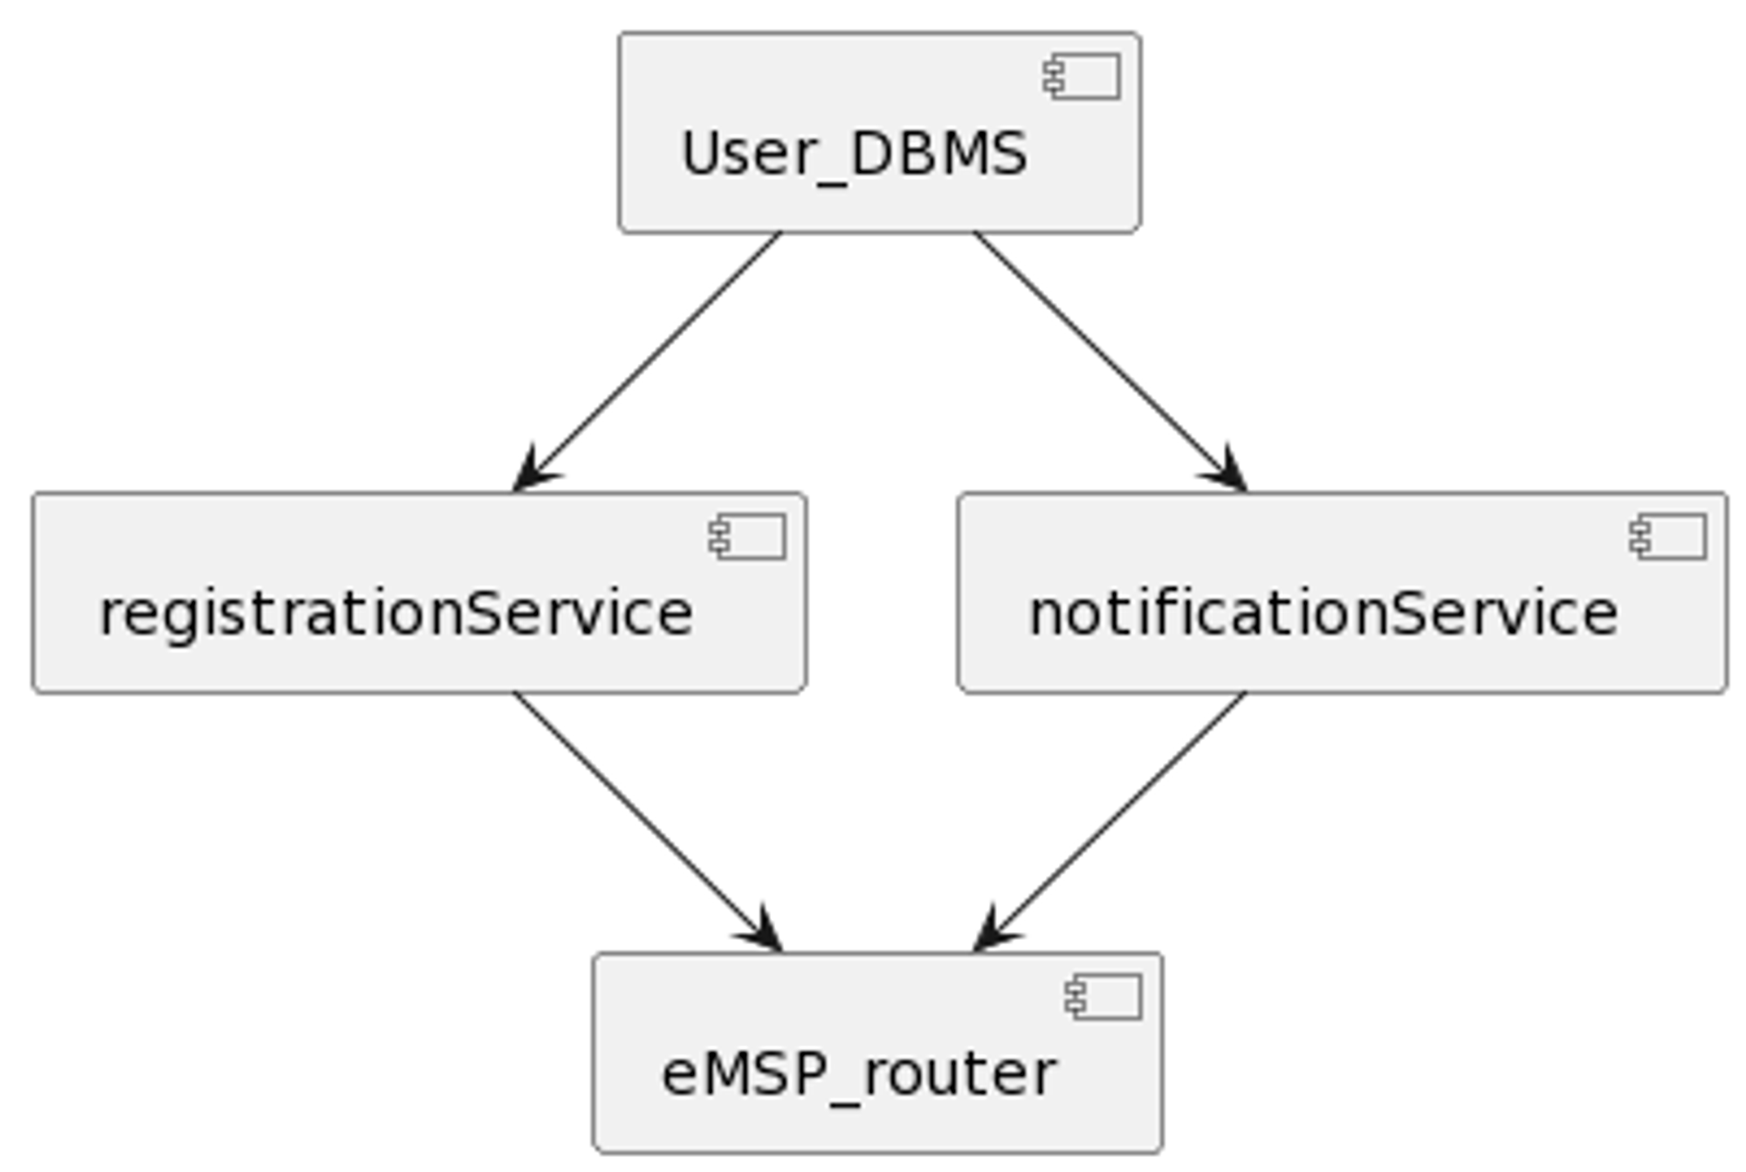
Implementation, integration and tests plan eMSP server
DD
Notes:
For the eMSP_server subsystem the integration plan choosen is the bottom-up approach, since both services have a clear dependency on the user_DBMS.
BOTTOM UP

Slide 22
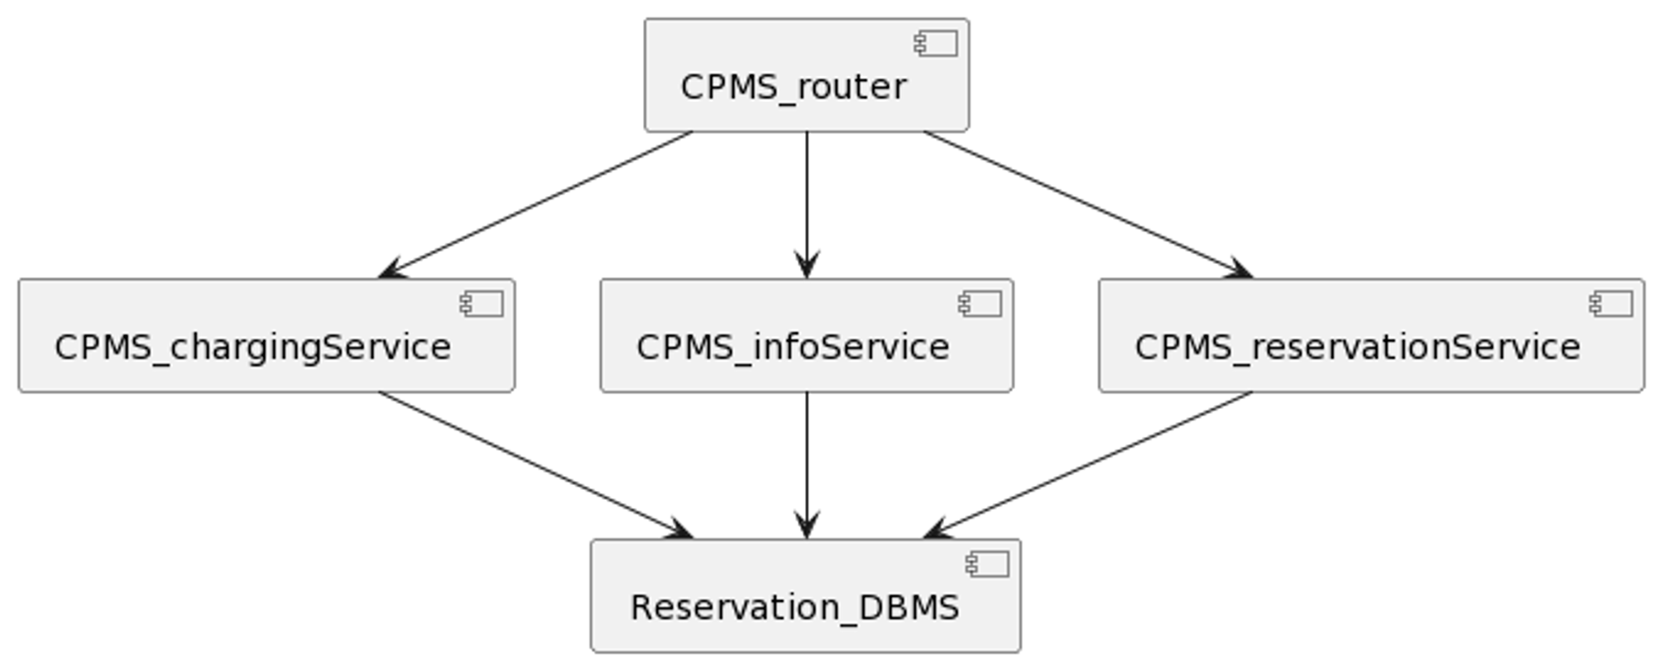
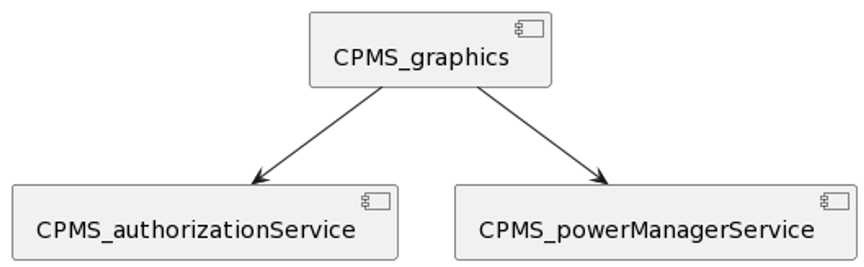
Implementation, integration and tests plan CPMS server
DD
PART 1
PART 2
Notes:
CPMS_server can be divided into two parts: as shown in the slide. This two parts can be implemented either in parallel or in sequence, each one following a top-down approach described in the following images.
TOP DOWN – either in parrallel or in series with part 2

Slide 23
Implementation, integration and tests plan CPMS server – part 2
DD
Notes:
CPMS_server can be divided into two parts: the first composed by the CPMS_graphics, CPMS_authorizationService and CPMS_powerMangerService, and the second one composed by CPMS_router, CPMS_infoService, CPMS_chargingService, CPMS_reservationService and reservation_DBMS. This two parts can be implemented either in parallel or in sequence, each one following a top-down approach described in the following images.
TOP DOWN

Slide 24
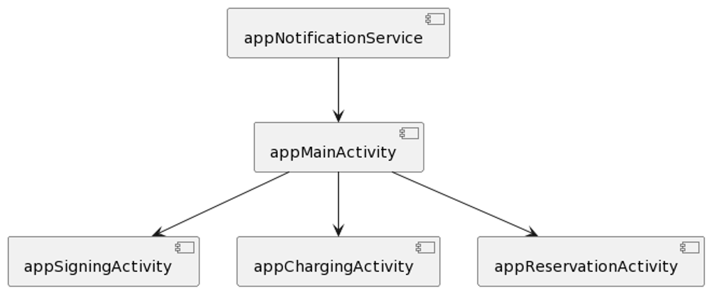
Implementation, integration and tests plan eMSP app
DD
Notes:
The eMSP_app can be also implemented following a top-down approach.

Slide 25
Thank you for your attention

